Slide 1
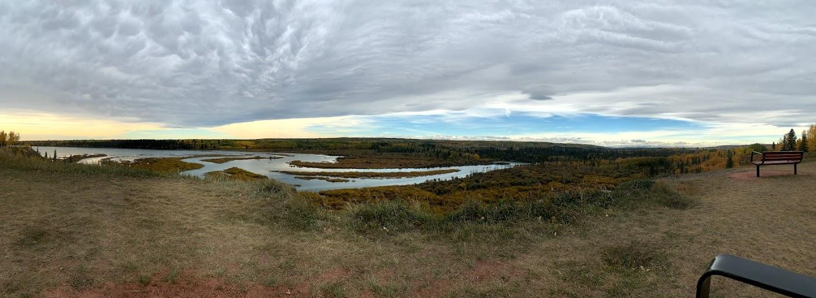
Field Trip Introduction
Notes:
Welcome to the Weaselhead. This is an introductory presentation to help you prepare for your upcoming field trip.

Slide 2
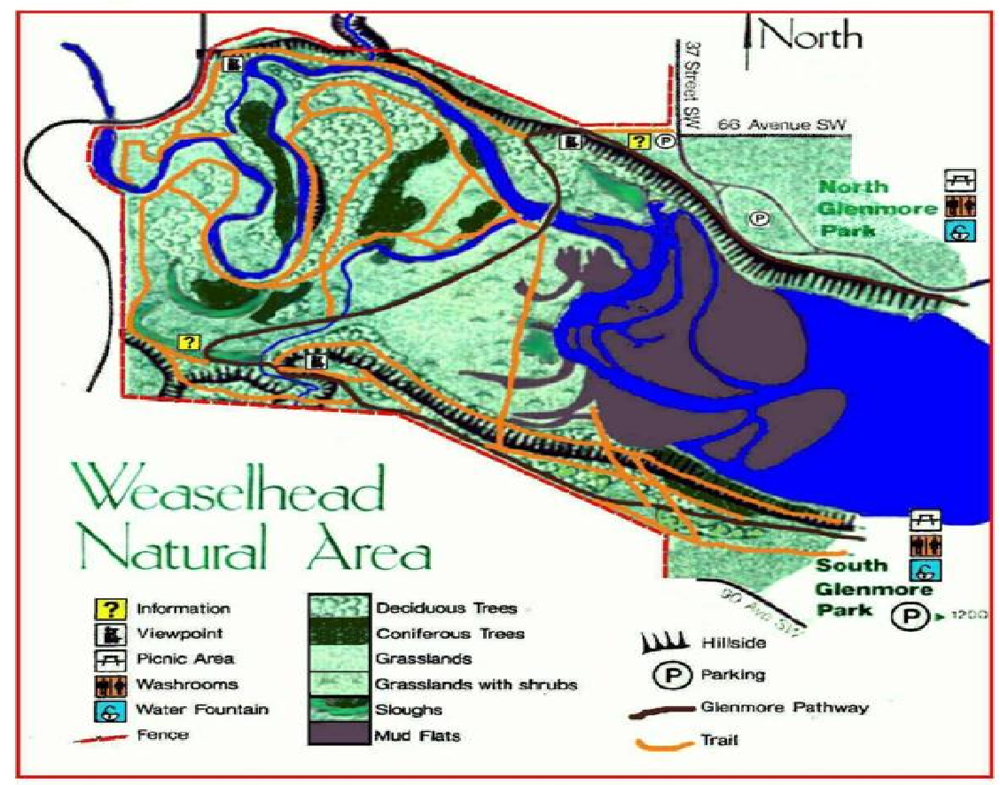
Notes:
Here is a map of the Weaselhead, it highlights some of the habitats and pathways you will be exploring. If you want more information on exact locations, visit our website for more information.

Slide 3
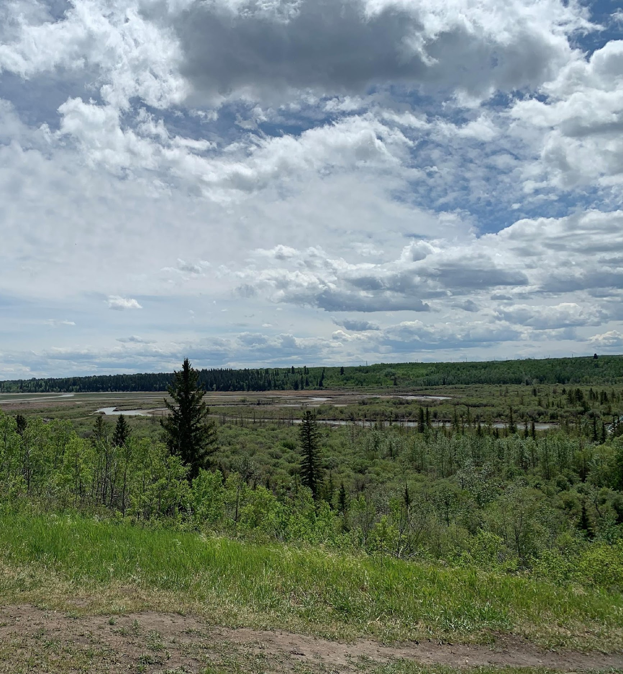
Weaselhead History
1994: Weaselhead/Glenmore Parks Preservation Society (WGPPS) was formed
WGPPS is a non-profit
Educate and conserve with and for the community
Notes:
In 1994, the Weaselhead/Glenmore parks preservation society formed as a non-profit organization with a mission to advance and foster environmental learning, experiences, protection, and appreciation in order to support communities that embrace and conserve our natural spaces.

Slide 4
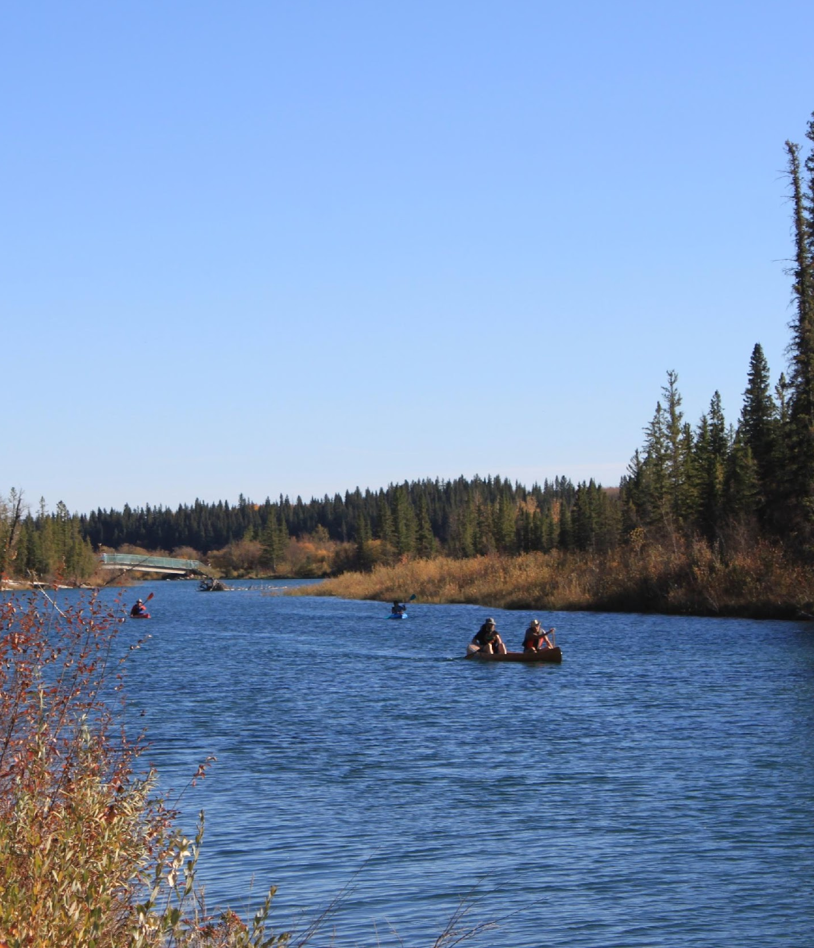
Weaselhead Water
The Elbow river flows through the Weaselhead into the Glenmore Reservoir
1 in 5 Albertans get their drinking water from the Weaselhead!
Notes:
So, a little bit about the water in the Weaselhead. The Elbow river flows through the park. As it slows down, it creates deltas and wetlands. Eventually it becomes the Glenmore Reservoir, which provides 1 in 5 Albertans with their water!

Slide 5
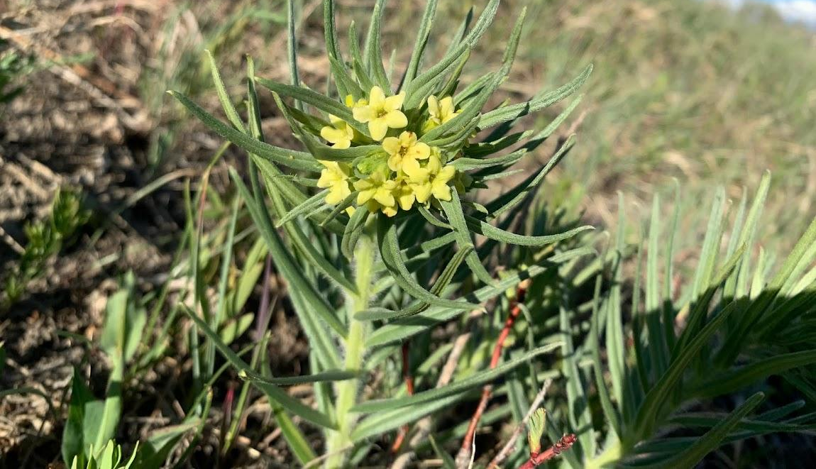
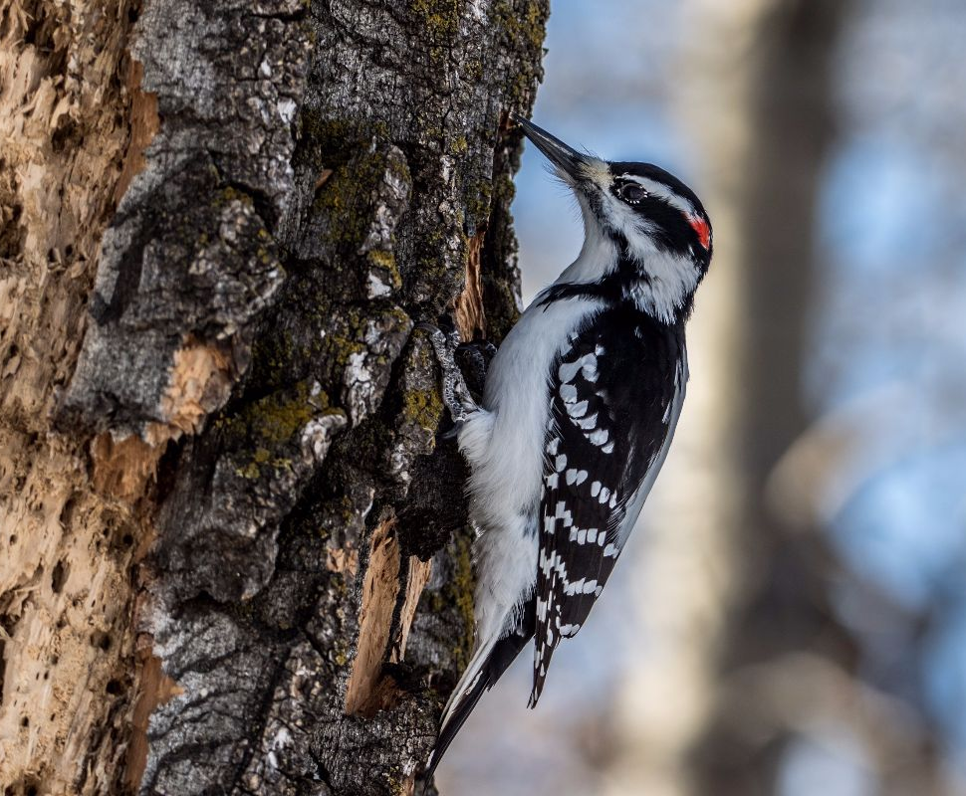
Weaselhead Wildlife
6 different habitats
Grassland ecosystem
Aspen stand
Riverine forest
Tall shrub
Wetland
Spruce grove forest
Over 1,000 different species of plants and animals
Source: Bob Lefebvre
Notes:
Image Source (Male Hairy Woodpecker): https://birdscalgary.com/winter-birds-weaselhead/
In the Weaselhead, we have 6 different habitats for you to explore, ranging from grasslands, forests, and wetlands! Everywhere you go, you will also find some of the thousand species that live here. Including insects, plants like puccoon seen at the top of the slide, birds like the hairy woodpecker seen on the bottom, ungulates like deer and many more!

Slide 6
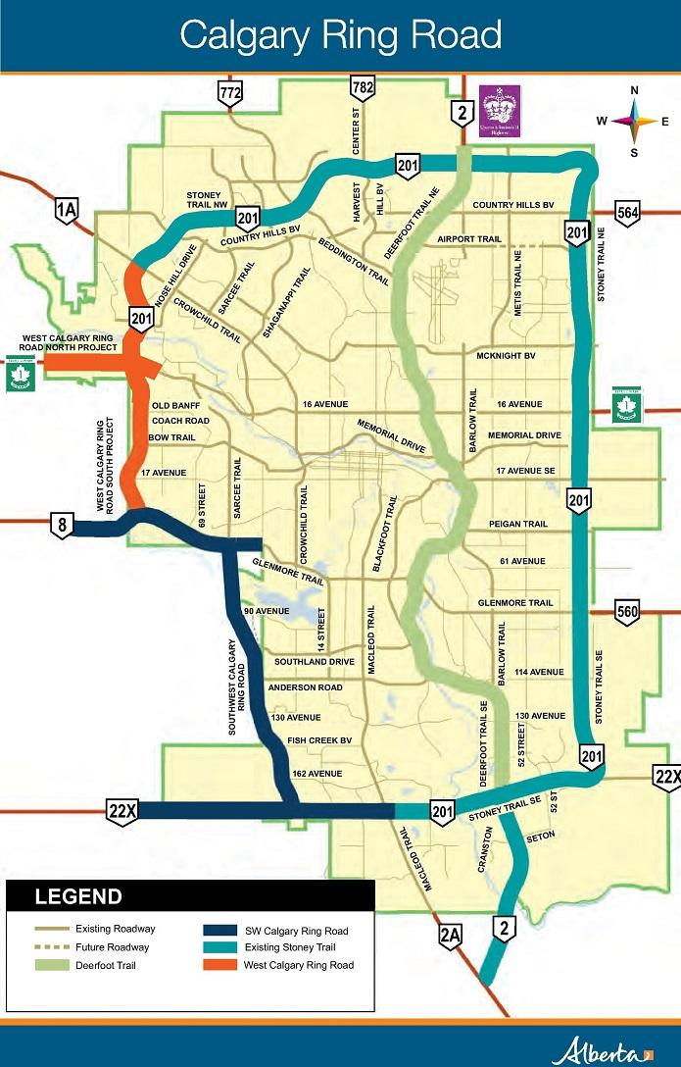
Southwest Calgary Ring Road (SWCRR)
Commissioned SWCRR Impact Study (2016-2022)
Impacts on terrestrial and aquatic ecosystems
Impacts include:
Multiple sediment spills
Water quality
Noise level
Wildlife movement
Hydrology
Source: Government of Alberta
Notes:
Image source: https://www.alberta.ca/calgary-ring-road-overview.aspx
From years before construction until the second year after the SWCRR’s completion, the Society commissioned a study to assess and compare the impacts on environmental indicators to those predicted in the Alberta Government’s Environmental Impact Assessment. Due to annual monitoring, mitigating improvements concerning construction impacts have been requested and implemented.

Slide 7
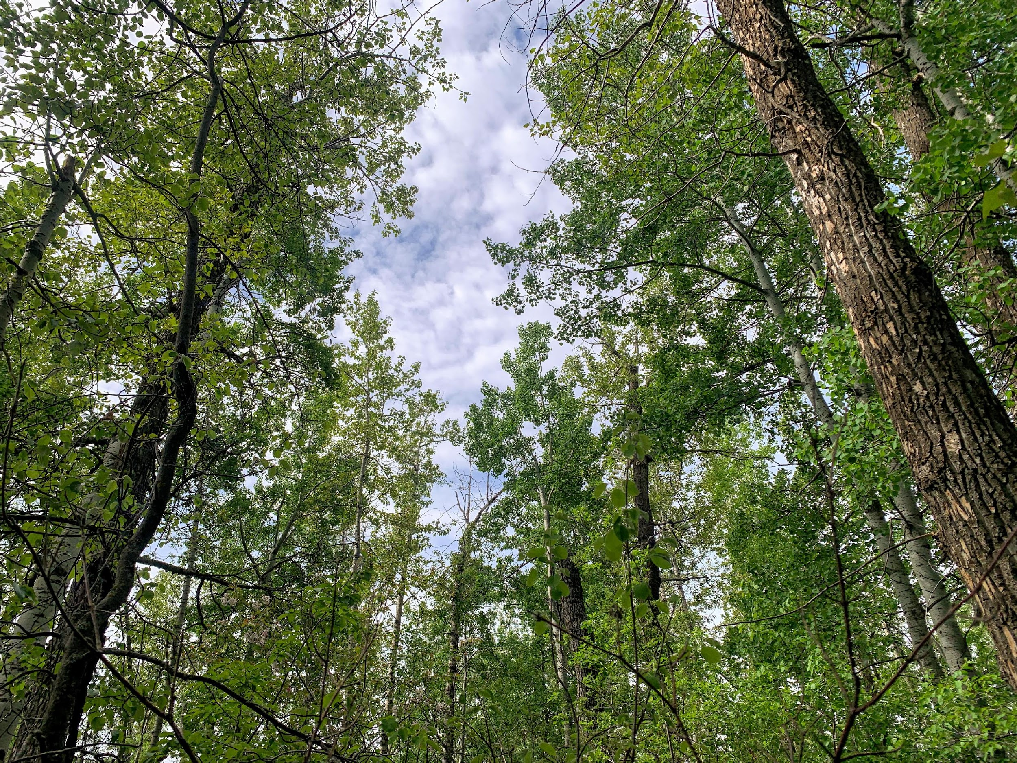
Pre-Trip Preparation
Set up a journal
Worksheets for grade 7-9
Extra paper
Bring writing utensil
Notes:
Before coming on your field trip you should prepare a few things. First, set up a journal containing the worksheet provided and extra paper so the students can sketch or take notes. Second, ensure everyone has a writing utensil. Another optional item is something to write on. For example, a clip board.

Slide 8
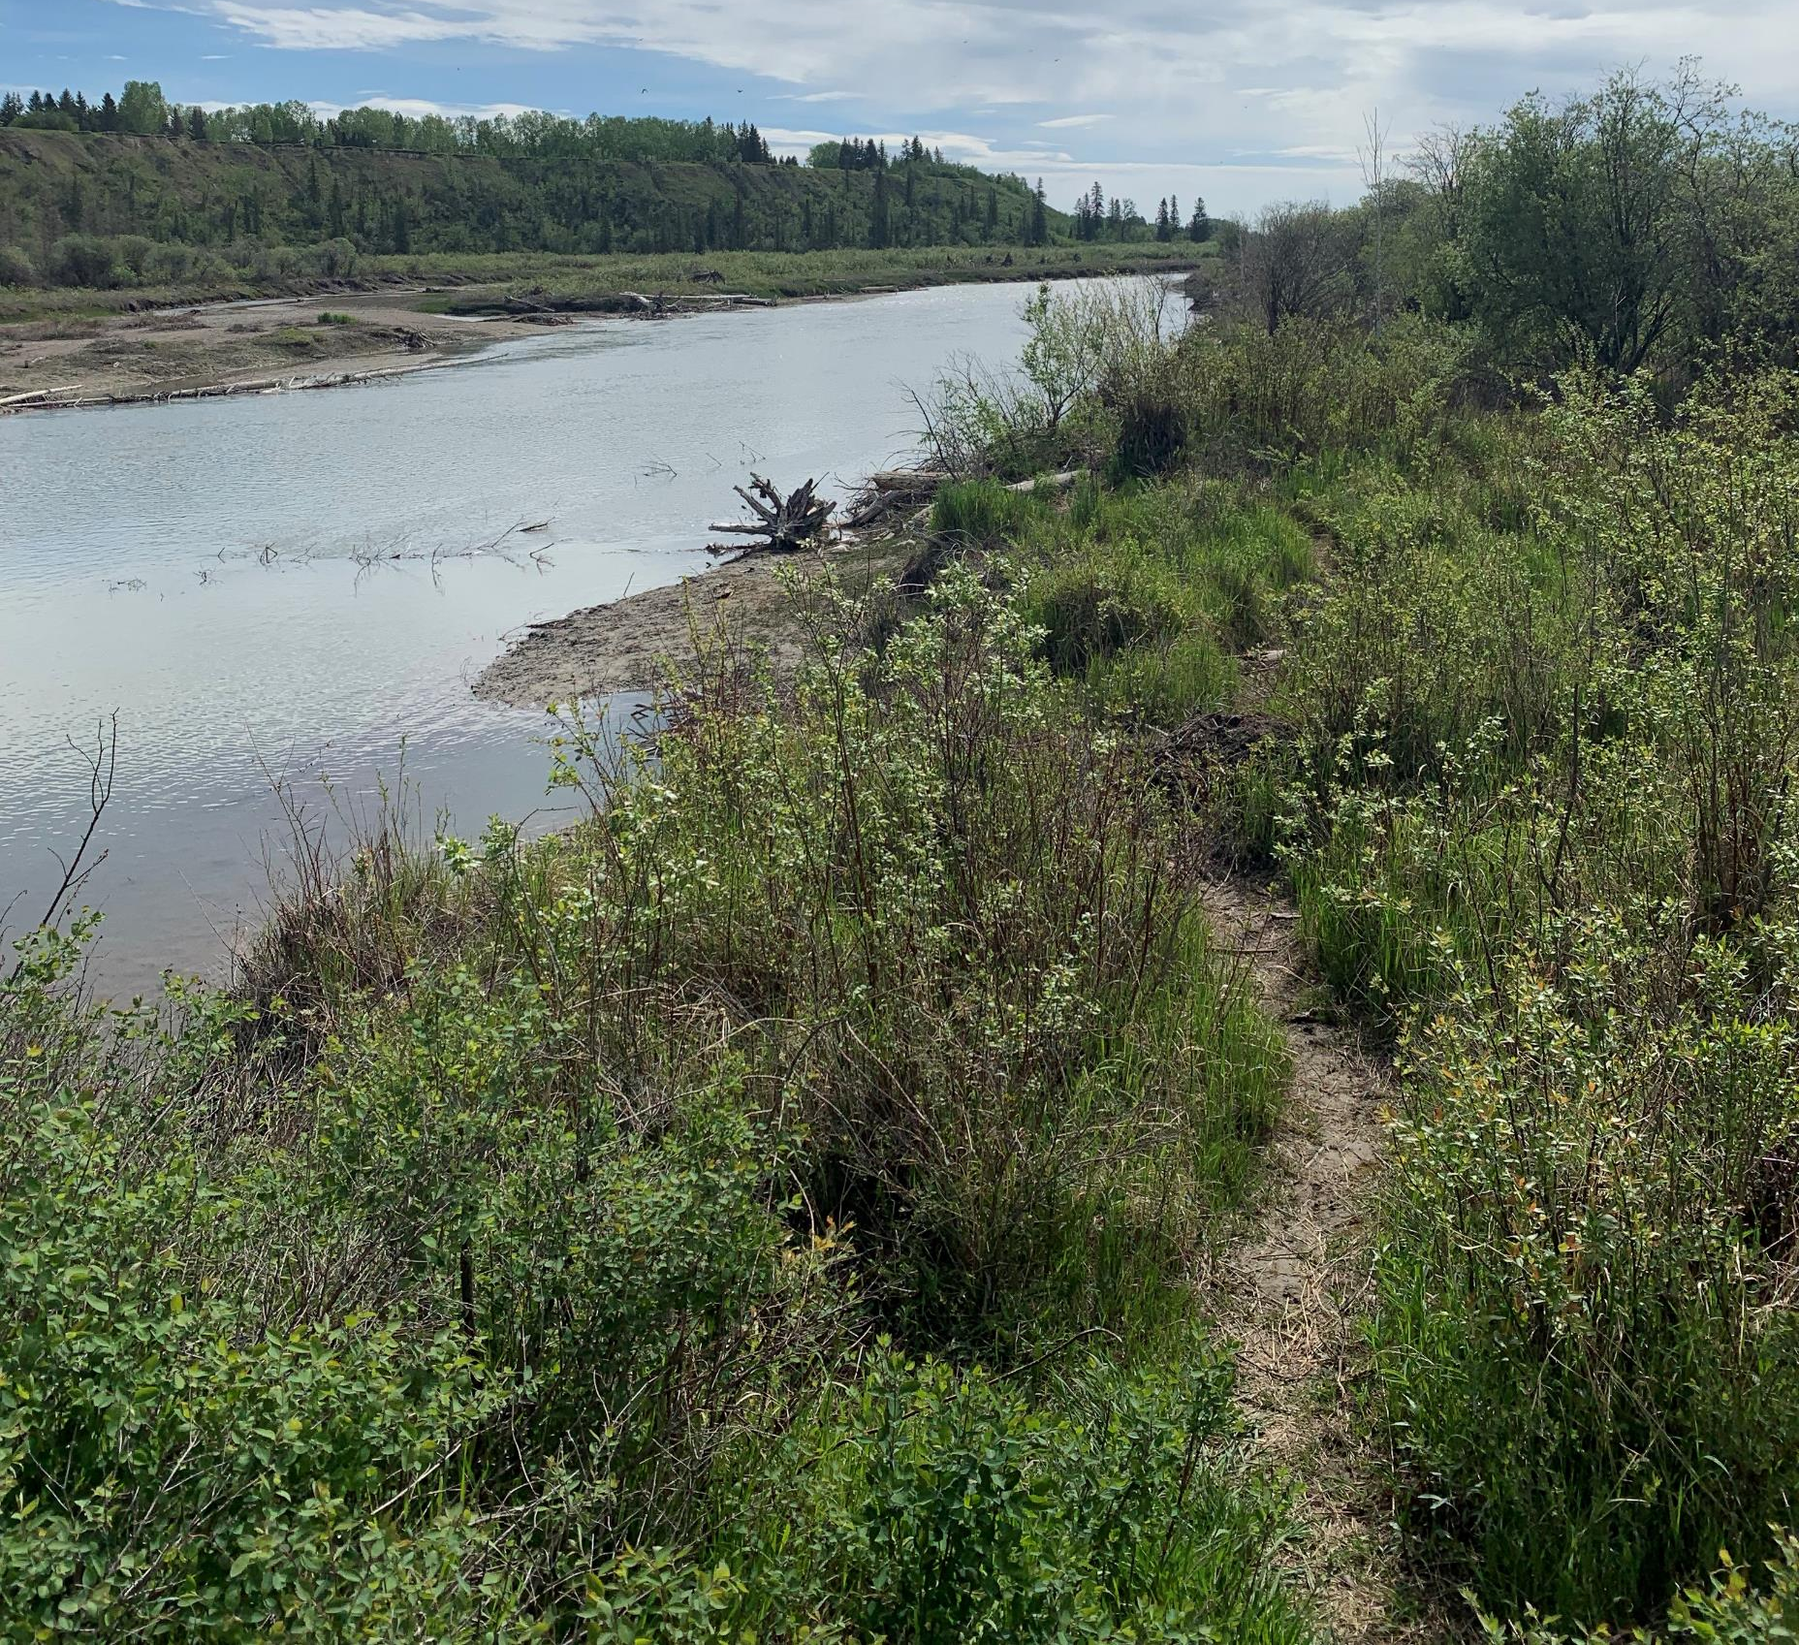
Pre-Trip Preparation
Terms to know
Biodiversity: The variety or abundance of different living things.
Bio = living
Diversity = variety of different things
Ecological footprint: Human impact.
A larger footprint = greater negative impact to the environment
Goal is to reduce your ecological footprint
Notes:
Lastly, there are some terms you should know before coming.
Biodiversity and ecological footprint.
Biodiversity is the amount of different living things within an ecosystem.
It is vital in supporting healthy ecosystems. For example, it allows for high-quality air, soil, and water. It also allows for the survival of all living organisms.
Let’s use an analogy. What if you were to eat only one thing for the rest of your life? That one type of food cannot provide you with every nutrient needed to function healthily.
Ecological footprint is the human impact on our ecosystems.
For example, eating local versus imported foods. The amount of carbon it takes to grow, package, transport, store, sell, and cook imported goods is vastly greater than purchasing locally grown food. You are decreasing your ecological footprint when you eat locally!

Slide 9
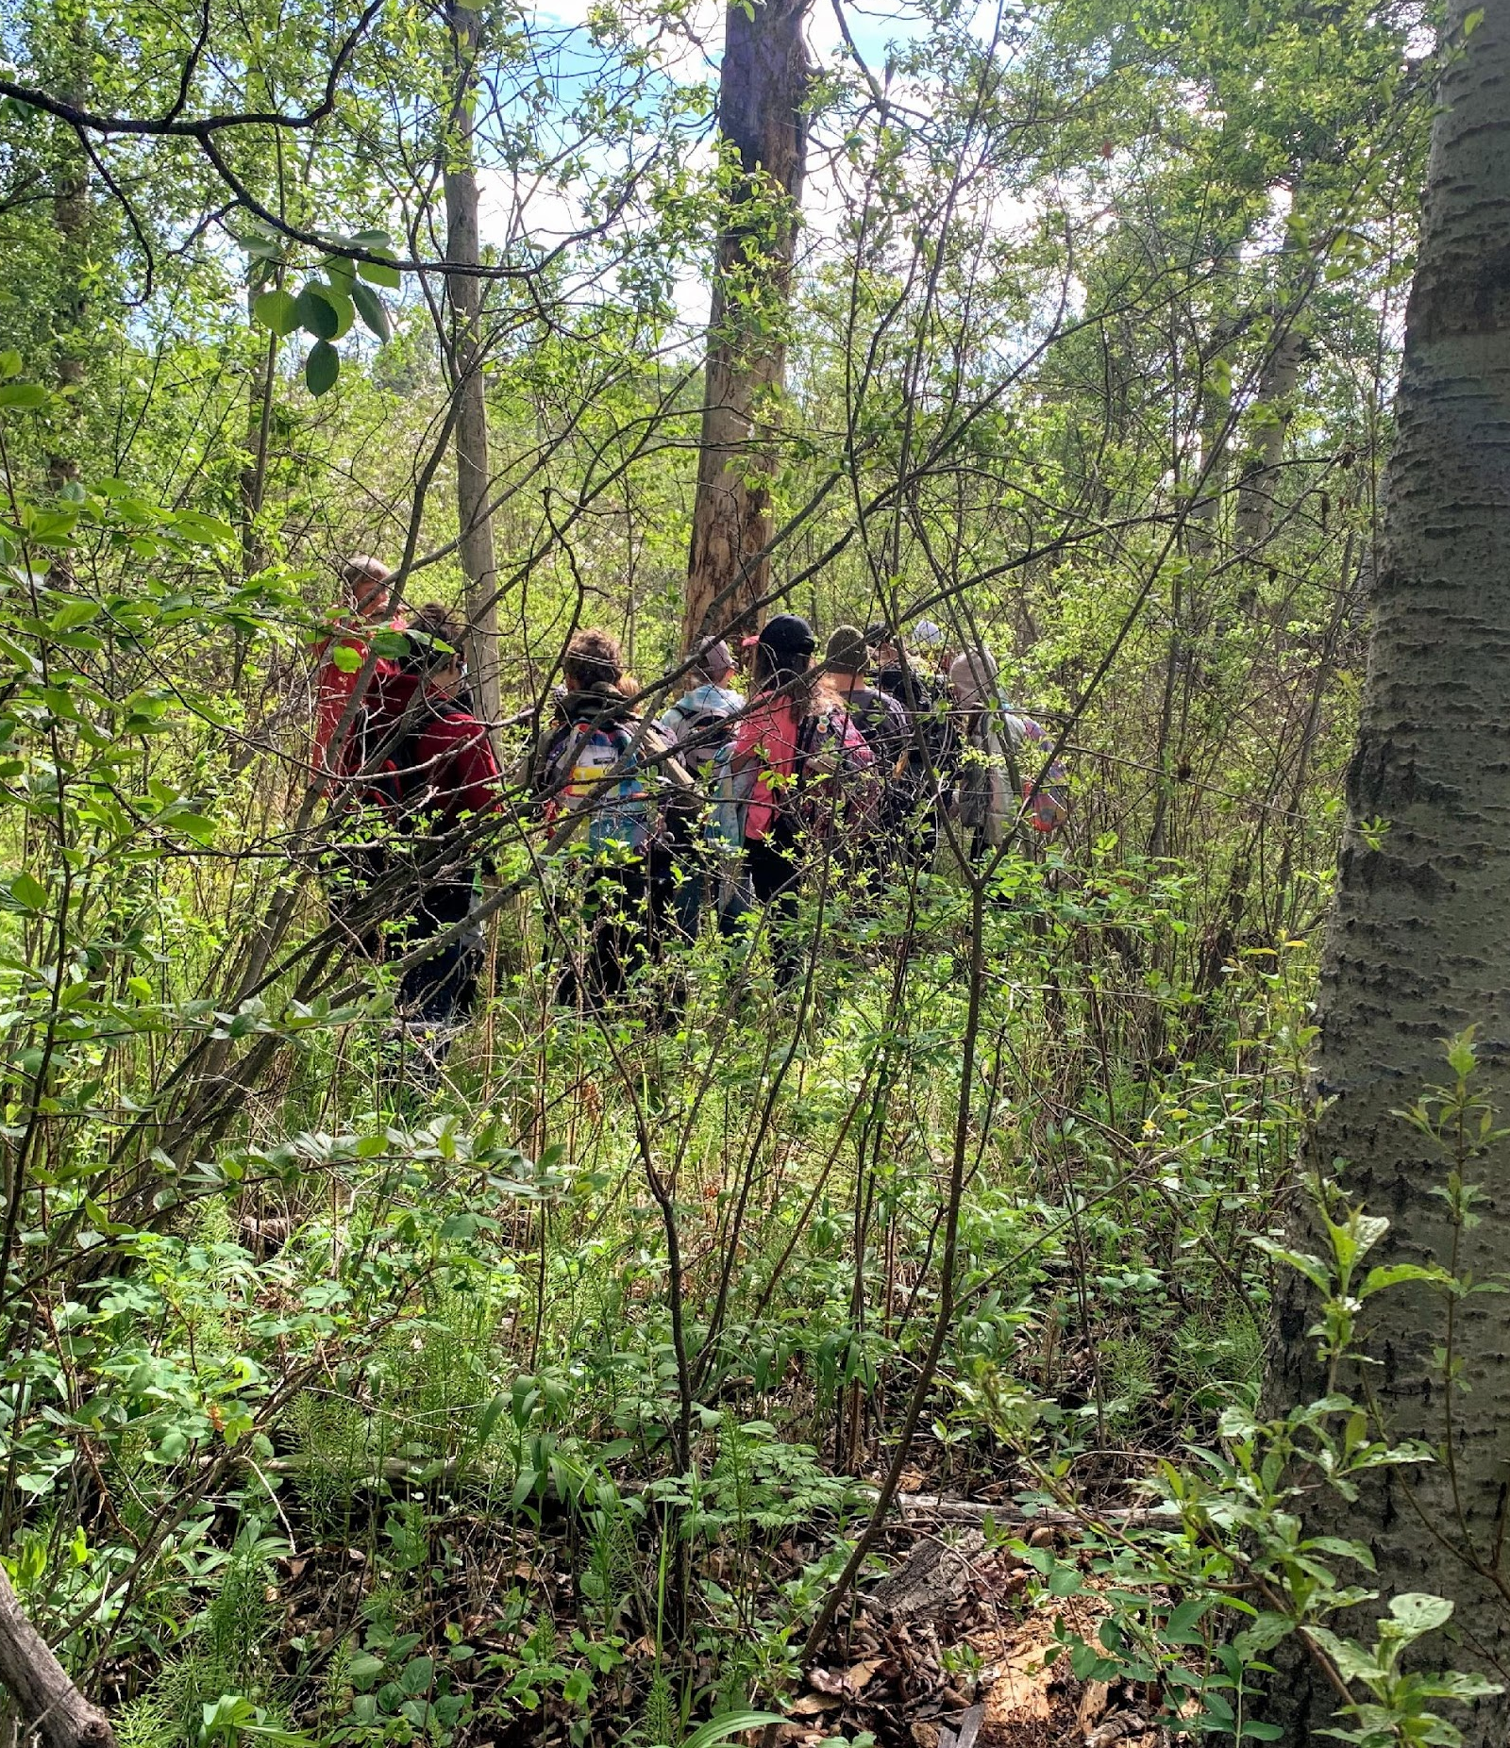
Field Trip - What to Bring?
Appropriate running shoes
Layered clothes (for ALL types of weather)
Water Bottle
Snacks
Lunch (for full day trips)
Journal and worksheets
Writing utensils
The ENTIRE field trip is outside, come prepared!
Notes:
What should you bring?
Everyone should have:
Appropriate running shoes/ boots if there is snow
Layers for ALL weather (i.e., rain, sun, cold, etc.)
Water Bottle
Snacks
Lunch for full day trips
Journal and worksheet
Writing utensil
Optional: something to sit on, like a pile of newspapers wrapped in a plastic bag.
It is vital to understand that the ENTIRE field trip is outside, so everyone must come prepared for the conditions!

Slide 10
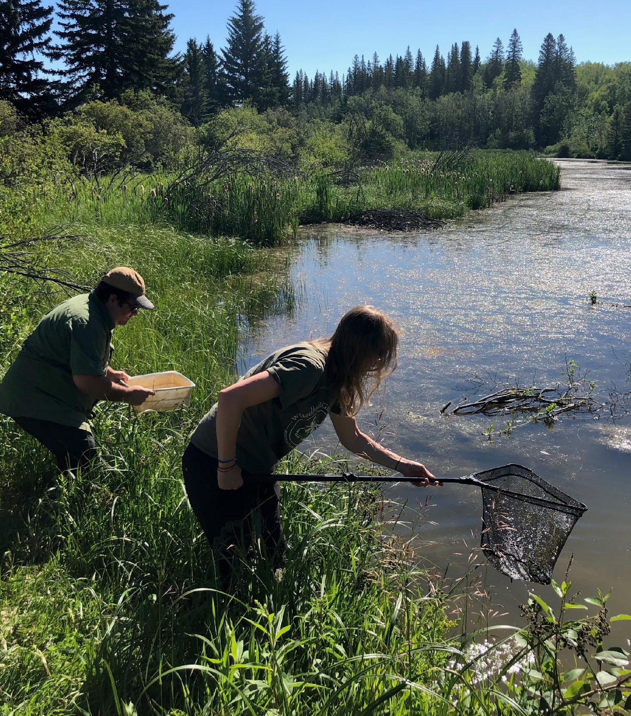
Field Trip - Behaviour Expectations
Remain in assigned group, and in sight of adult leaders always.
An adult leader will always be at the front and back of the group.
Leave no trace of our visit.
ALL garbage must be brought out by you.
Tripping, wrestling, teasing, and other unsafe behaviour is unacceptable.
May result in withdrawal from the activity.
Active and respectful participation in discussions and lessons is expected. Please leave headphones and earbuds at home.
Every adult is expected to participate and provide safety and care.
Adults and students should keep cell phones away unless there is an emergency.
Notes:
Behaviour Expectations:
Always remain with your assigned groups and in sight of adult leaders.
There will always be an adult leading, and someone at the back, sweeping the groups.
Leave no trace – ALL garbage must be packed out!
We expect the same behaviour as a classroom. Our classroom just does not have walls. Tripping, wrestling, teasing, and other unsafe behaviour is unacceptable.
Cooperation by listening, participating in group discussions, observing and recording is expected during the learning experience.
Each adult is expected to participate in the activities and provide due safety and care for each of the students.

Slide 11
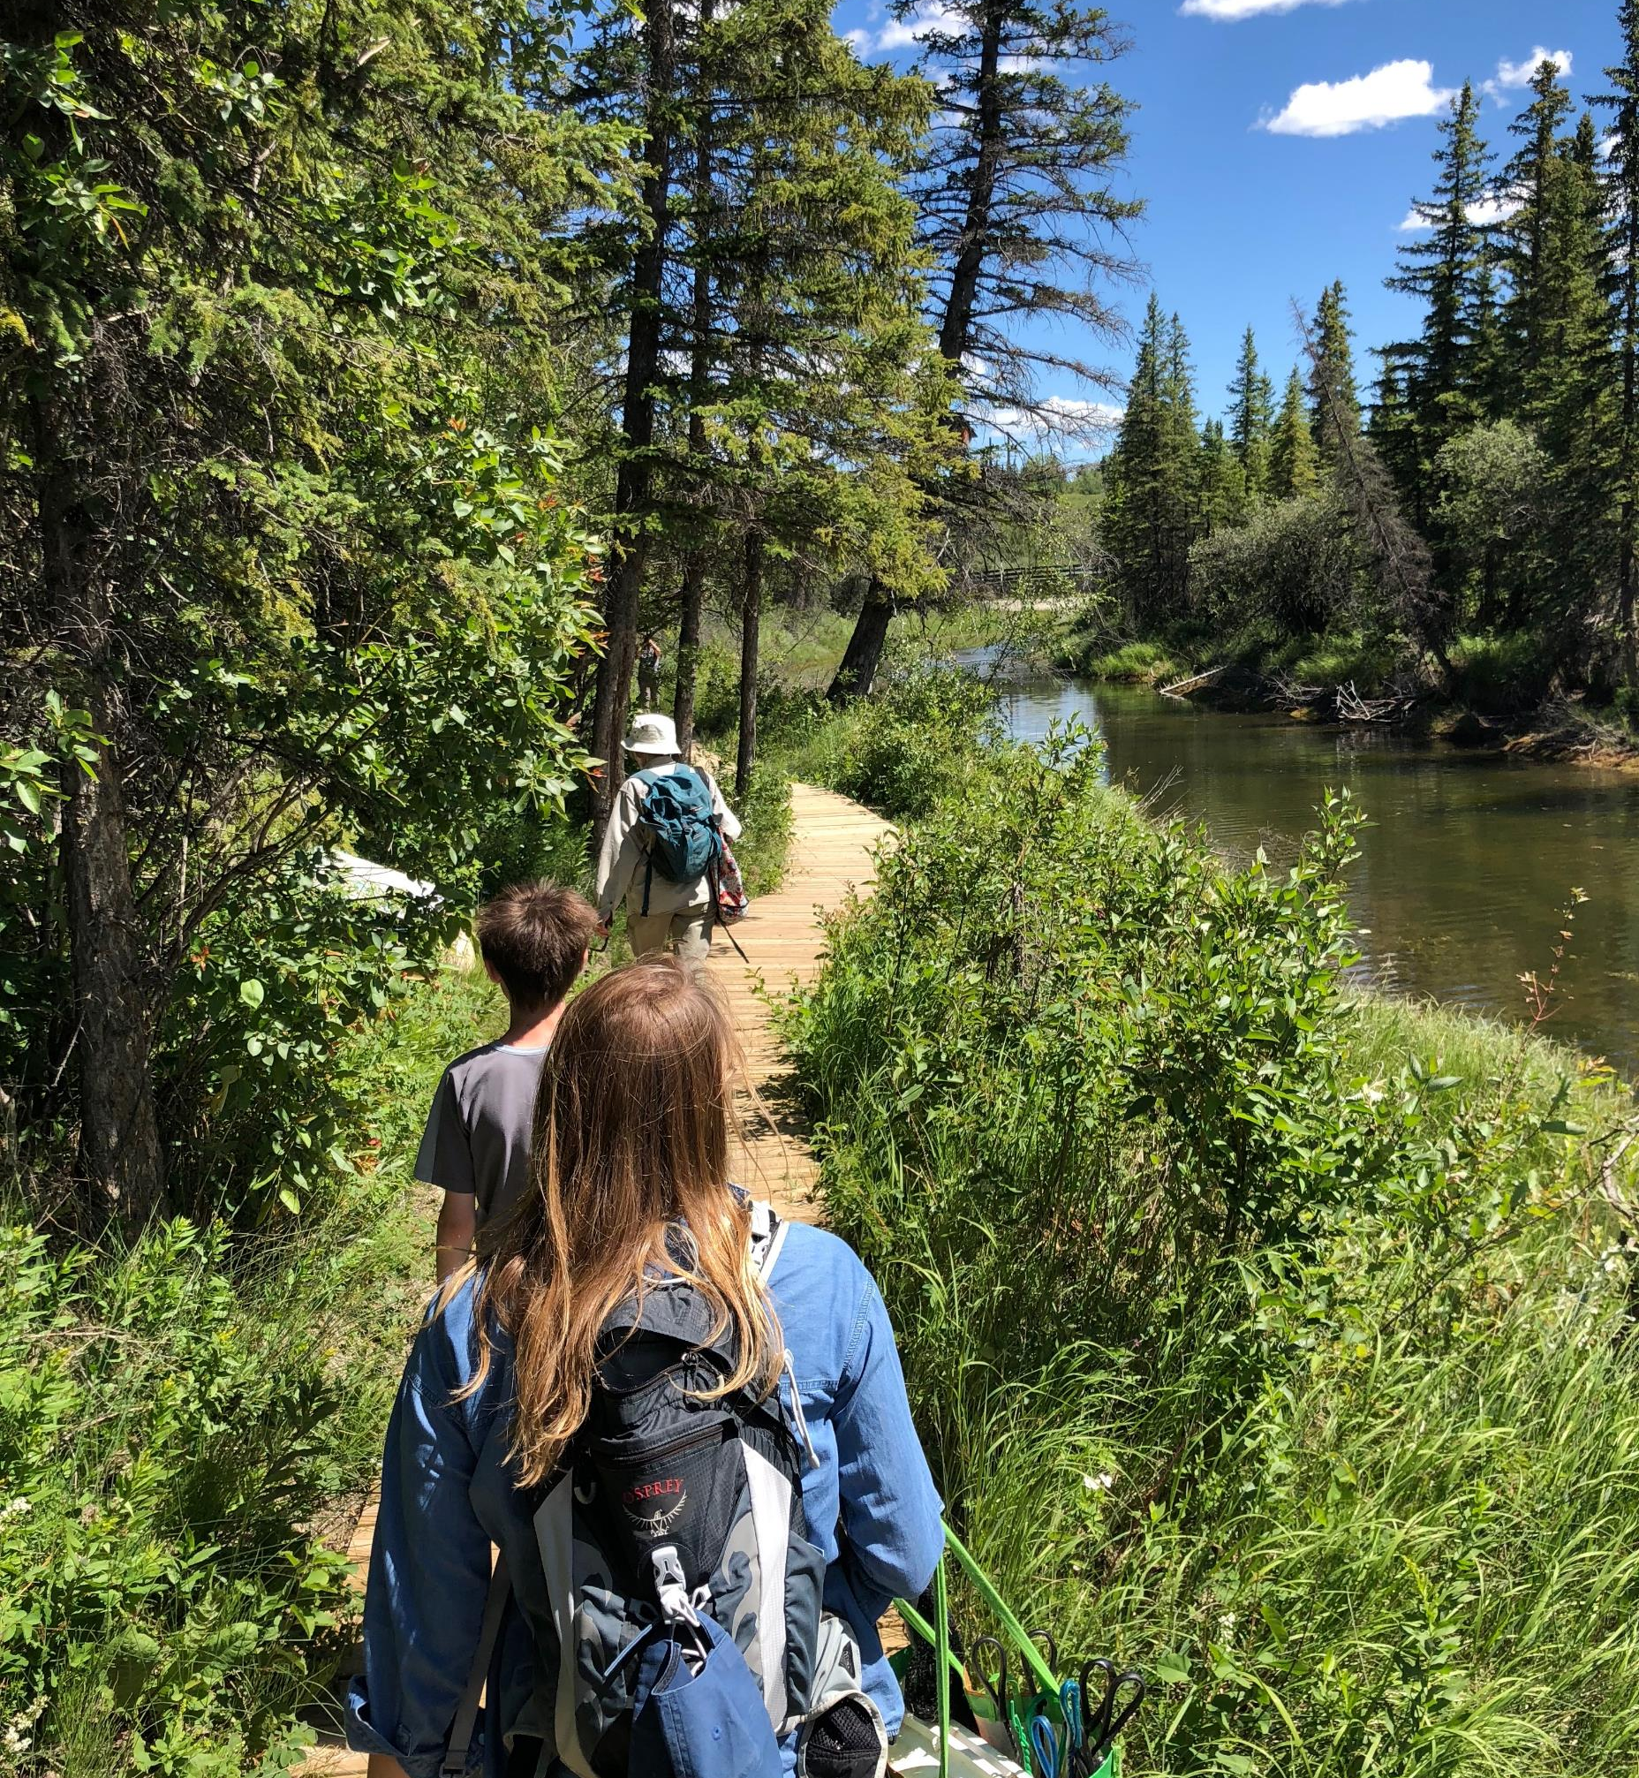
Field Trip - Trail Etiquette
NEVER remove natural items from the area.
Always stay to the right of the trail.
Be gentle with all living creatures you interact with.
Pets are not permitted on the field trip
Notes:
Trail Etiquette: these are expectations regarding the land itself!
First: NEVER remove natural items from the area: All living things need food, water, and shelter; if everyone were to pick, crush, or remove something, there would be nothing left for the living organisms in the park. We can be great stewards for the land so all organisms, including humans, can prosper.
Second: Always stay to the right of the trail.
Many other people use the park, and we need to be considerate of others' experiences!
Bikes often speed through the park without slowing down for others, it is important everyone stays to the right of the path, so nobody gets struck.
It is especially important on the hill that leads from the top of the Weaselhead, down into the river valley. There are blind corners that can be dangerous.
Third: Be gentle with all living creatures you interact with
We are entering their homes, and as their guests we need to be considerate of the effort they are putting into surviving and thriving! Help them preserve the land by being respectful of their space.
Finally, Pets are not permitted

Slide 12
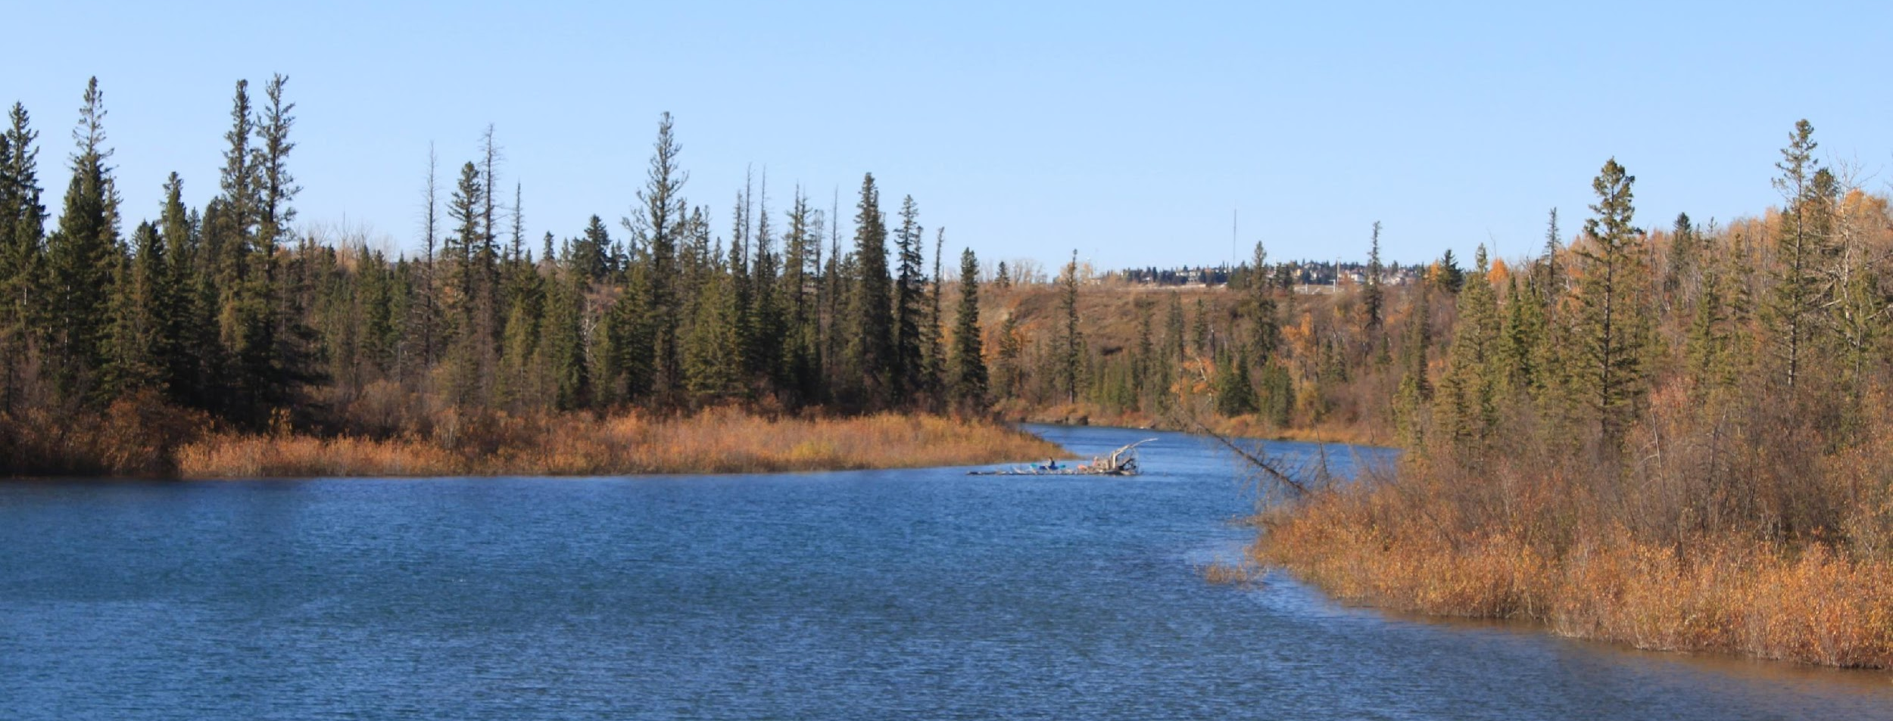
Thank you!
We appreciate you for coming to the Weaselhead and look forward to your visit.
Notes:
Thank you so much for coming to the Weaselhead for your field trip! We hope you come and learn from, play in, and experience our wonderful park.

